Slide 1
Programming for Psychologists
Lecture 4 September 24 2018
http://osdoc.cogsci.nl

Slide 2
Today
More on drawing to the canvas
Various shapes
Images
Pausing experiment and working with multiple canvases
Placement of stimuli
Random
Grid
Circle (next week)

Slide 3
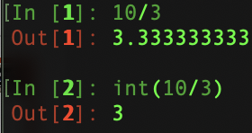
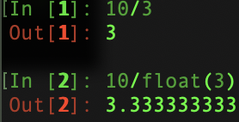
Number division in Python
Python 3 (assignments 1 -4) | Python 2 (assignments 5 - 13)

Slide 4
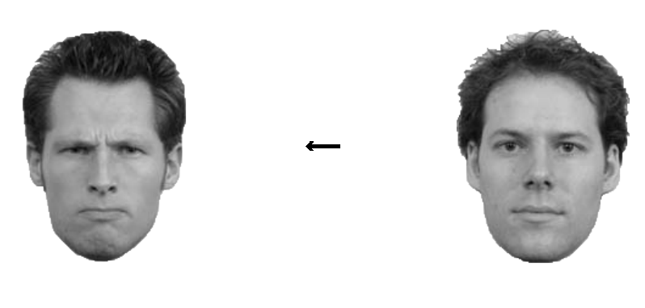
(Full) factorial design
Often, an experiment consists of (multiple) blocks of trials
Independent variables (e.g., stimulus position, cue direction, etc) are varied within these blocks
Consider the following experiment (assignment 7)
Arrow direction (left or right)
Angry face location (left or right)
SOA (100, 300, 500)

Slide 5
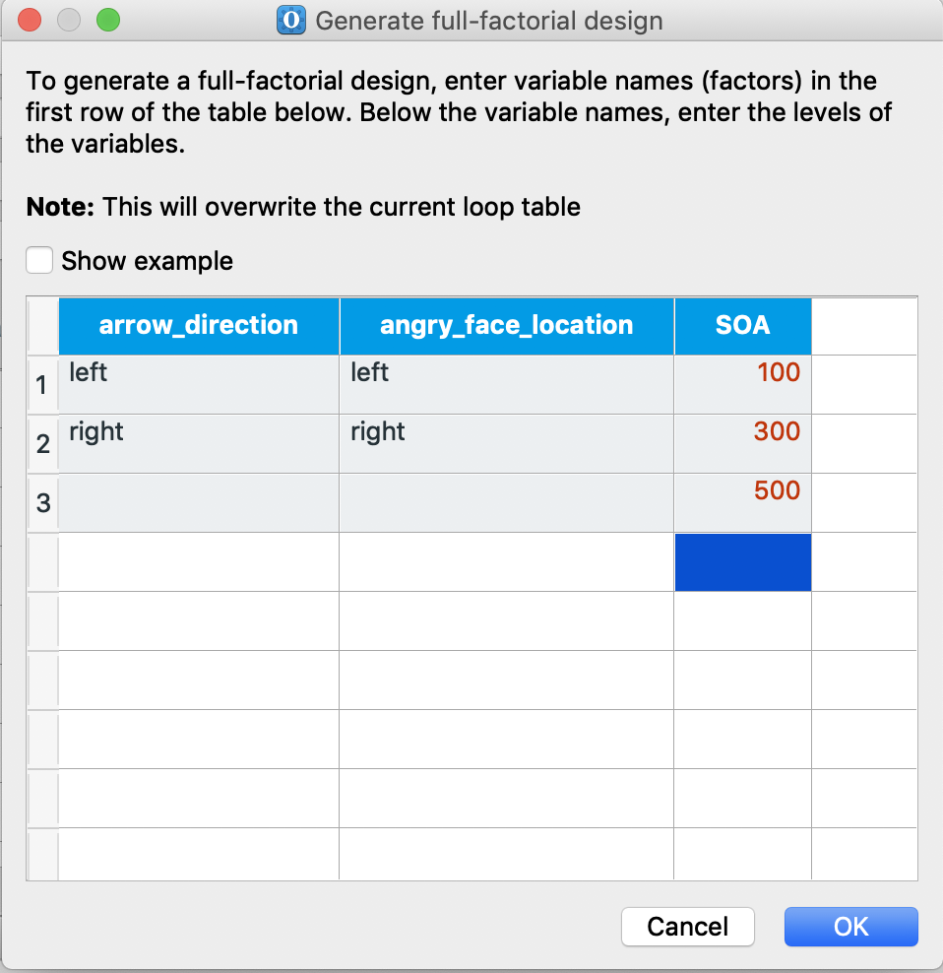
Full Factorial design
This experiment thus contains 2 x 2 x 3 = 12 levels
No need to enter all possible combinations by hand
Use the variable wizard in OpenSesame (via full factorial design option)
Each column in the resulting table
corresponds to a trial in trial_sequence
You can add new variables to the
resulting loop table (e.g., correct response)

Slide 6
Canvas drawing options
OpenSesame has a lot of drawing options, e.g.,:
Circles
Rectangles
Arrows
Images
gabor
A whole list can be found here:
https:/osdoc.cogsci.nl/3.2/manual/python/canvas/

Slide 7
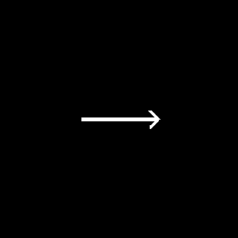
Other functions for drawing to the Canvas:
Canvas drawing options
xc = my_canvas.xcenter()
yc = my_canvas.ycenter()
my_canvas.arrow(xc-50,yc,xc+50,yc)
line/arrow(sx,sy,ex,ey)

Slide 8
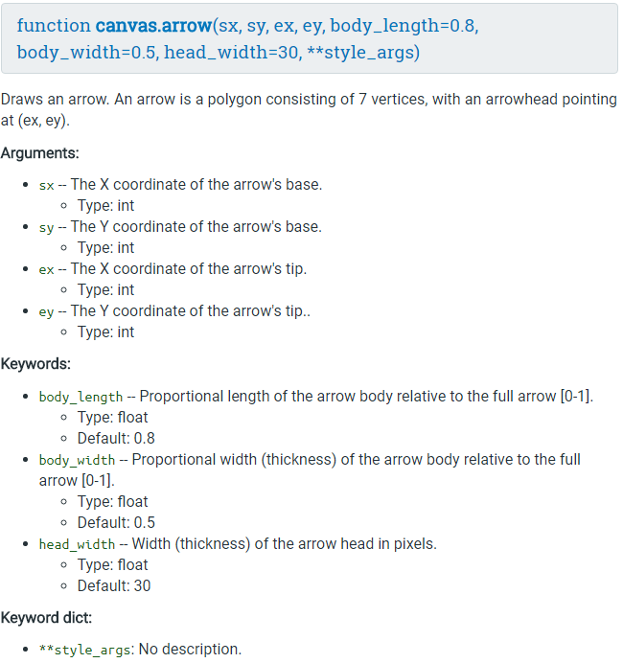
You must provide these values
cnvs.arrow(3,4,5,6) ≠ cnvs.arrow(4,3,5,6)
cnvs.arrow(3,4,5,6) = cnvs.arrow(sy=4,sx=3,ex=5,ey=6)
Default values are provided
If you don’t like it, you can change them, like:
cnvs.arrow(3,4,5,6,
body_width=.2)
Standard setting you can change, like color
cnvs.arrow(3,4,5,6,color=“red”)

Slide 9


Other functions for drawing to the Canvas:
Canvas drawing options
xc = my_canvas.xcenter()
yc = my_canvas.ycenter()
my_canvas.circle(xc,yc,25)
my_canvas.circle(xc,yc,25,fill=True)
line/arrow()
circle(x,y,radius)

Slide 10

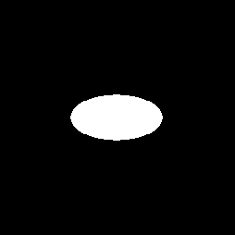
Other functions for drawing to the Canvas:
Canvas drawing options
xc = my_canvas.xcenter()
yc = my_canvas.ycenter()
my_canvas.ellipse(xc,yc,40,20)
my_canvas.ellipse(xc,yc,40,20,fill=True)
line/arrow()
circle()
ellipse(x,y,w,h)

Slide 11
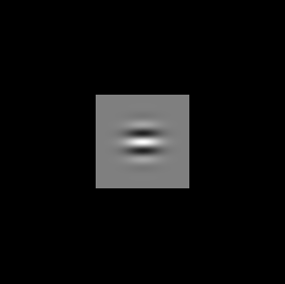
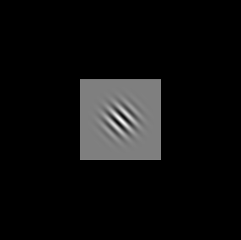
Other functions for drawing to the Canvas:
Canvas drawing options
xc = my_canvas.xcenter()
yc = my_canvas.ycenter()
my_canvas.gabor(xc,yc,0,3)
my_canvas.gabor(xc,yc,45,10)
line/arrow()
circle()
ellipse()
gabor(x,y,orient,freq)

Slide 12
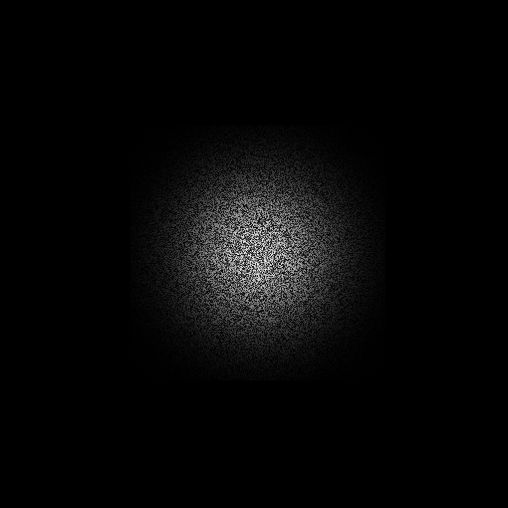
Other functions for drawing to the Canvas:
Canvas drawing options
xc = my_canvas.xcenter()
yc = my_canvas.ycenter()
my_canvas.noise_patch(xc,yc)
line/arrow()
circle()
ellipse()
gabor()
noise_patch(x,y)

Slide 13
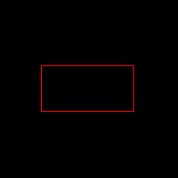
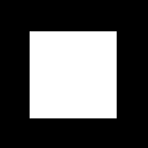
Other functions for drawing to the Canvas:
Canvas drawing options
xc = my_canvas.xcenter()
yc = my_canvas.ycenter()
my_canvas.rect(xc,yc,100,50,color=“red”)
line/arrow()
circle()
ellipse()
gabor()
noise_patch()
rect(x,y,w,h)
my_canvas.rect(xc,yc,100,100,fill=True)
(x,y) will be top-left corner of rect!

Slide 14
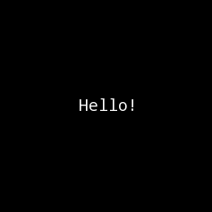
Other functions for drawing to the Canvas:
Canvas drawing options
xc = my_canvas.xcenter()
yc = my_canvas.ycenter()
my_canvas.text(“Hello!”)
line/arrow()
circle()
ellipse()
gabor()
noise_patch()
rect()
text(str)

Slide 15
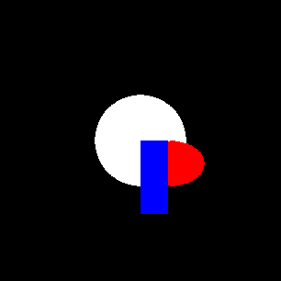
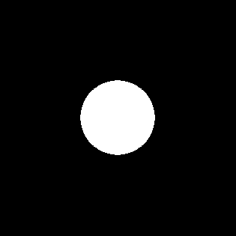
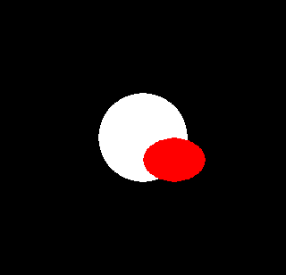
Canvas drawing options
Order of drawing statements matter!
Newest drawing performed on top of older drawings
my_canvas.circle(xc, yc, 50, True)
my_canvas.ellipse(xc.yc,70,10,True,“red”) #drawn on top of the circle
my_canvas.rect(xc,yc,30,80,True,"blue") #on top of ellipse (and circle)

Slide 16
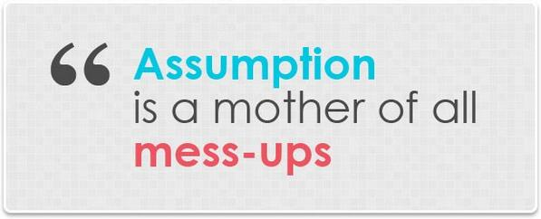
Main message: Always check online how functions work (I always have an idea, but I’m never sure)
(If you are not sure, then CHECK it)

Slide 17
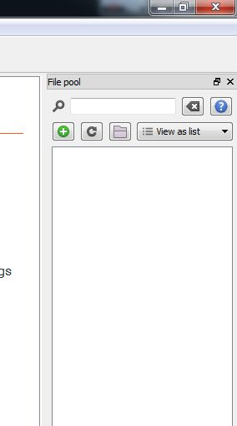
Displaying images on the canvas
To use images, you have to put them in the file pool:
“View > Show file pool” or Ctrl + P
Drag and drop images

Slide 18
Displaying images on the canvas
First, create a reference to the desired image from the file pool with: img=var.get_file(“image_name_here.jpg")
Then draw the image to the canvas by passing its reference to the function my_canvas.image(): my_canvas=canvas()
my_canvas.image(img)
my_canvas.show()

Slide 19
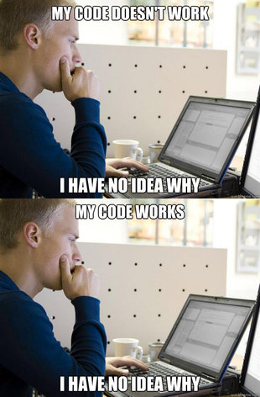
Displaying an image
my_canvas.image(var.get_file(“programming.png”))

Slide 20
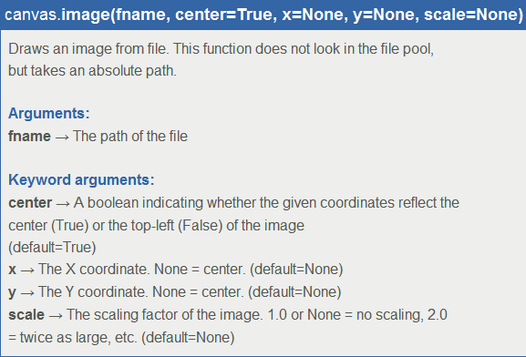
Other options of canvas.image()

Slide 21
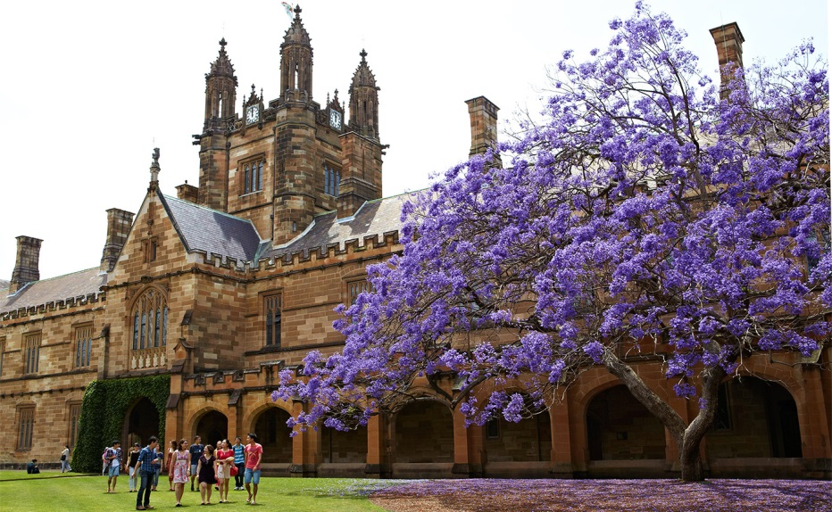

Determine size of image with scale
my_canvas.image(var.get_file(“australia.jpeg”), x=xc/2, y=yc)
my_canvas.image(var.get_file(“australia.jpeg”), x=xc/2+xc, y=yc, scale=0.5)
Scale = 1.0 is normal size, scale = 0.5 is half the original size, etc.

Slide 22
Pausing the experiment
Occasionally, you want to pause the execution of a script for a moment (for instance when showing stimuli on the screen)
clock.sleep()
Enter time to pause in milliseconds
clock.sleep(1000) # Pause for 1 second
clock.sleep(60000) # Pause for 1 minute
clock.sleep(50) # Pause for 50 milliseconds

Slide 23
Working with multiple canvases
sleep() is also useful when you work with multiple canvases
Imagine an experiment in which we want to show 5 images in a row (e.g. for a memory test) and want to display each image for 1 second before continuing to the next image

Slide 24
Working with multiple canvases
Prepare:
Run:
images =['australia.jpeg','clock.jpeg',\ 'keyboard.jpeg','roadsign.jpeg',\ 'seagull.jpeg']
# Create empty list to hold canvases canvases = []
# Loop through images list for img in images: # Get reference to image from file # You can auto assign! img = var.get_file(img) # Create a new canvas to show image on new_cnvs = canvas() # Show image on canvas new_cnvs.image(img) # put this canvas in list canvases.append(new_cnvs)
# Show canvases on screen # Keep each canvas on screen for 1 sec for cnvs in canvases: cnvs.show() var.sleep(1000)

Slide 25
An example of multiple canvases
Attentional blink experiment (task: identify the red letters)
A
A
G
G
T
T
S
S
Q
Q
Single task condition
Y
Dual task condition
Y
H
H
L
L

Slide 26
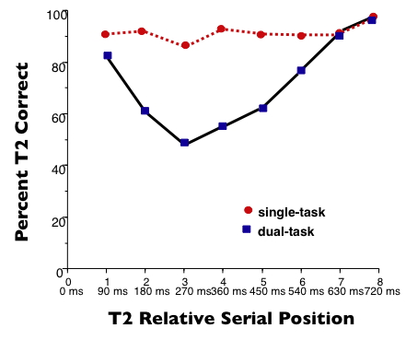
Attentional blink
(Raymond, Shapiro & Arnell, 1992)

Slide 27
Attentional blink
(Very) basic AB experiment steps:
Prepare phase:
Create a list of letters, and randomize it
Select two letters from the list as targets
Create a canvas for each letter
Draw targets as red letters, and distractor as white letters
Run phase:
For each canvas:
Show for 50 ms Clear its contents Show empty canvas for another 50 ms
In a real experiment (not in this example): participants report the identity of one or two letters (depending on the task)

Slide 28
Attentional Blink
Prepare:
Run:
import random
letters = ["A","E","F","O","Q","P","C",\
"W","U","P","X","V","B","Z","K","D"]
canvases = []
random.shuffle(letters)
targets = [3,5]
for loc,letter in enumerate(letters):
my_canvas = canvas() #color is white
if loc in targets: my_canvas.set_fgcolor("red")
my_canvas.text(letter)
canvases.append(my_canvas)
# Show each canvas
for new_canvas in canvases:
# Show canvas on screen for 50 ms
new_canvas.show()
var.sleep(50)
# Clear the canvas (make it black) # and show for 50 ms
new_canvas.clear()
new_canvas.show()
var.sleep(50)
# Repeat for next canvas

Slide 29
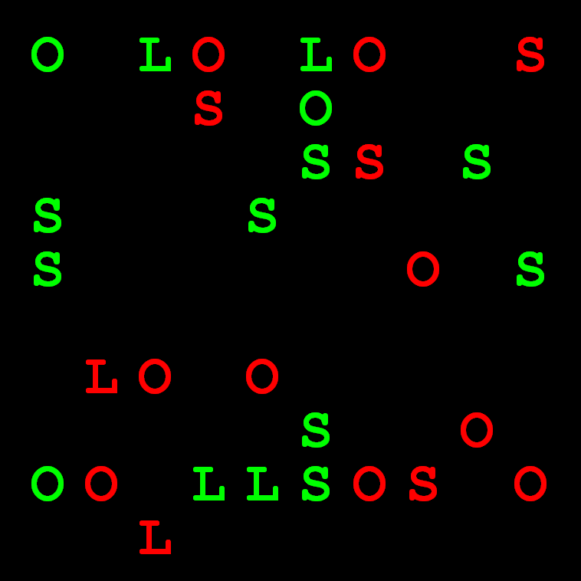
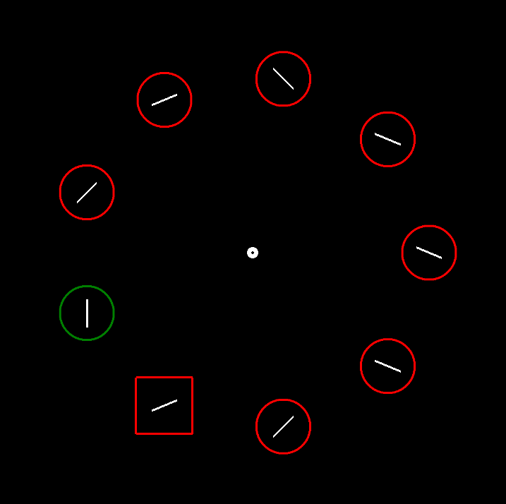
Stimuli presentation
When you need to present multiple stimuli on the same canvas concurrently, you need to choose where to place them:
Random
Grid
Circle
There are of course many other options

Slide 30
Stimuli placement: random (assignment 8)
Random placement:
Randomly choose an x coordinate between boundaries set by screen width:
Left_boundary < x < right_boundary
Randomly choose an y coordinate between boundaries set by screen height:
Top_boundary < y < y bottom_boundary
Draw stimulus at this location
Repeat above for each stimulus you want to show

Slide 31
Stimuli placement: random

Slide 32
Stimuli placement: random
Draw 20 red circles (radius=10) to random positions on the screen:
To generate random numbers (for x and y), use random.randint(a,b) Return a random integer N such that a <= N <= b
To get the width and height of the screen use: my_canvas = canvas()
my_canvas.width and my_canvas.height

Slide 33
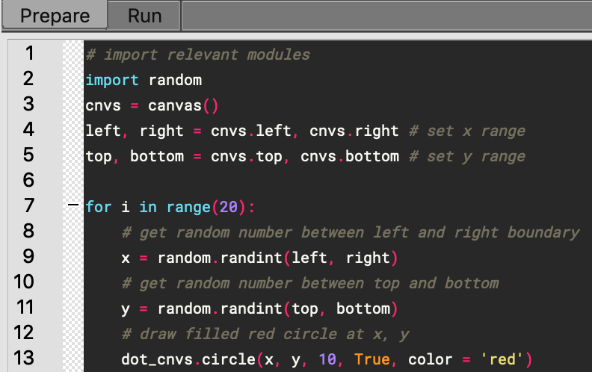
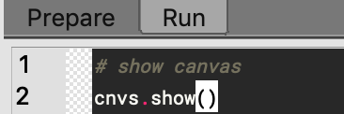
Stimuli placement: random
Draw 20 red circles (radius=10) to random positions on the screen:
Prepare:
Run:

Slide 34
Stimuli placement: random
Dangers of random positioning:
Stimuli can be drawn on top of each other
You have no control over the distance between stimuli
Overall least control in placement of all methods

Slide 35
That's it for today!

